Slide 1
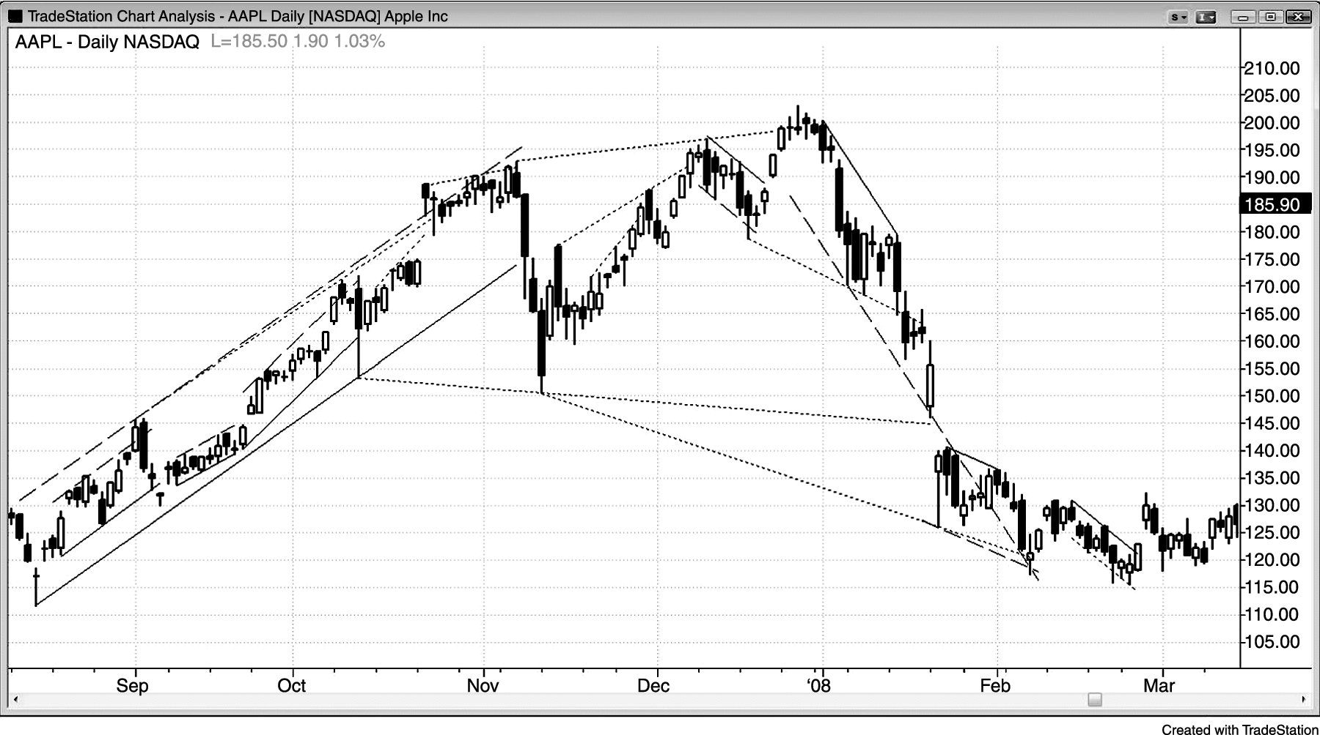
FIGURE 14.1 Testing a Trend Channel Line

Slide 2
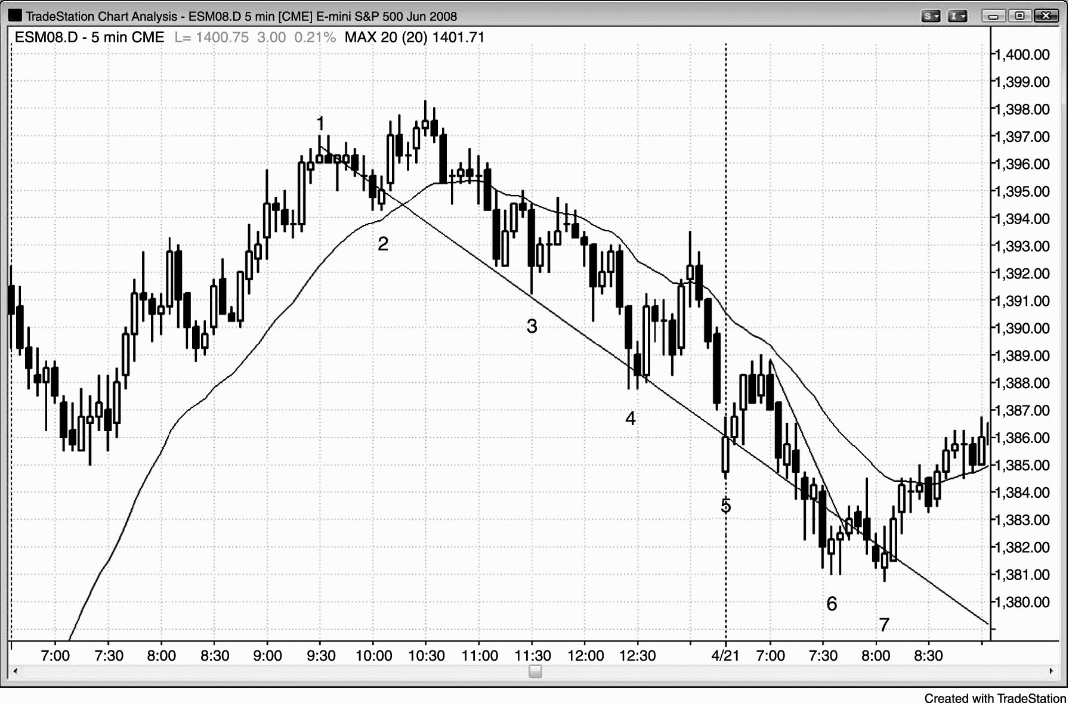
FIGURE 14.2 Slope of the Final Flag

Slide 3
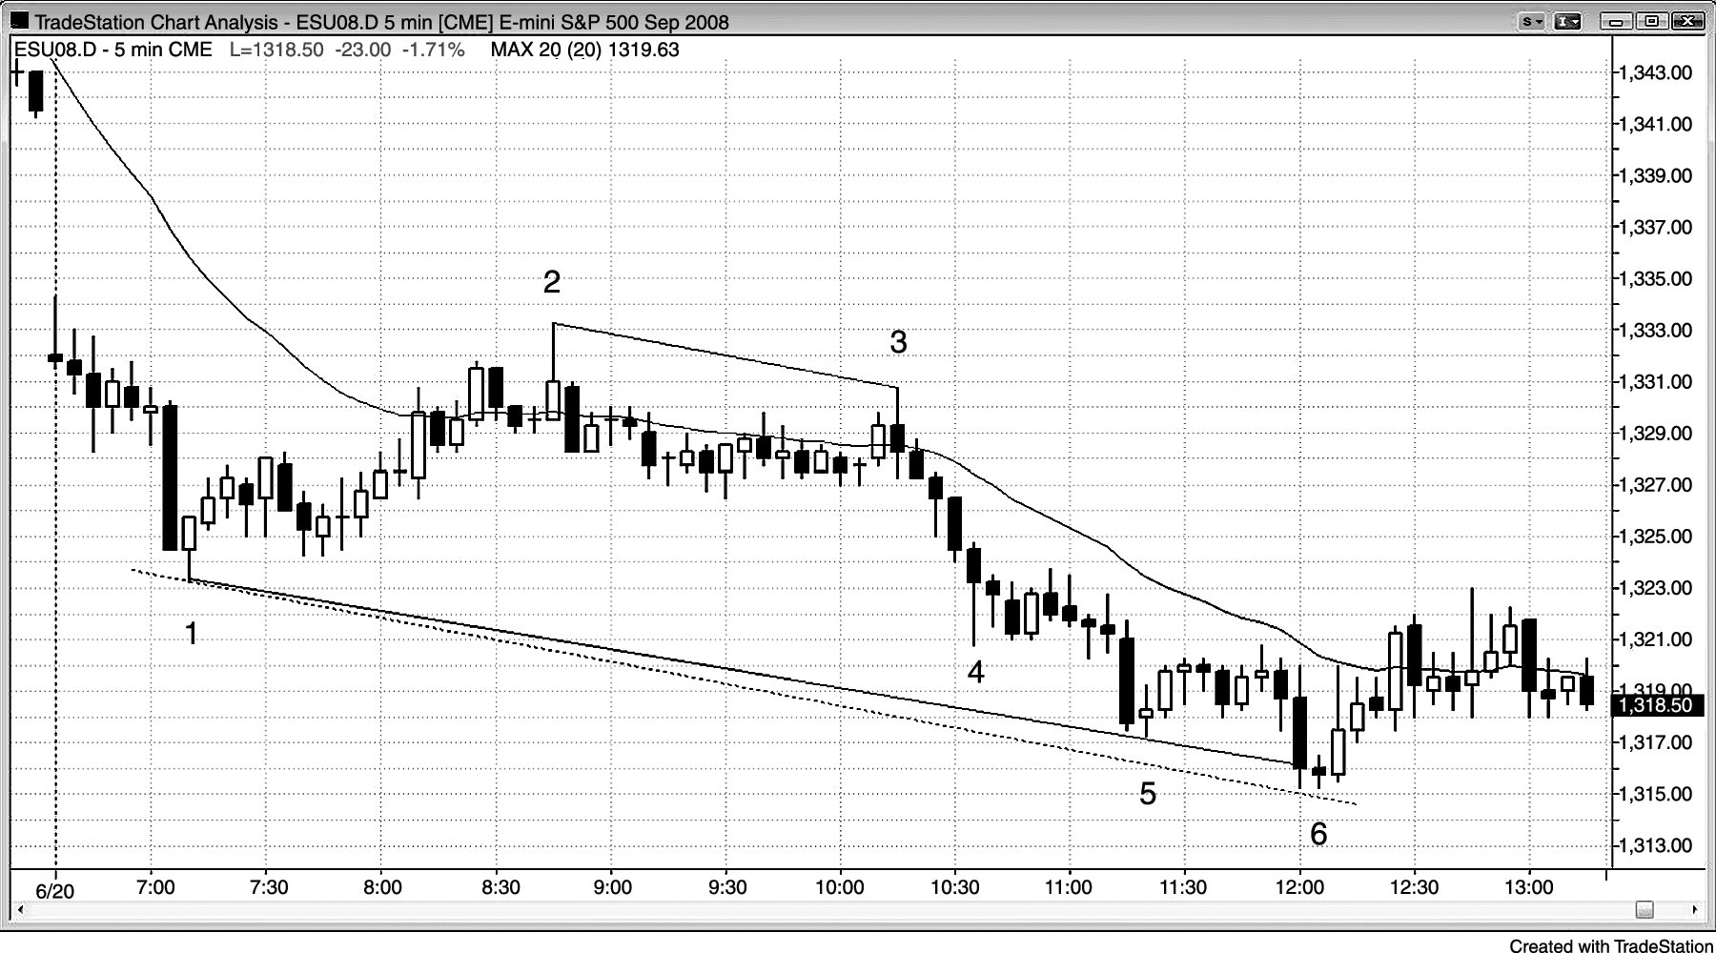
FIGURE 14.3 Lengthy Trend Channel Line

